Slide 1


Analyzing Youth Well-being in Sokoto
This presentation details the workflow and insights from a data analysis project focused on understanding the mood and activity patterns of Nigerian corps members in Sokoto. Our goal is to uncover meaningful correlations to enhance well-being initiatives.
by Sule Andah

Slide 2




Data Analysis Workflow: From Collection to Insights
Data Collection
Cleaning & Preparation
Data was collected from corps members using an editable Google Sheet link, ensuring easy and direct input.
DeepSeek AI was leveraged to clean and structure the raw data, transforming it into a refined TSV file for analysis.
Kaggle Upload
Visualization & Interpretation
The cleaned dataset was then uploaded to Kaggle, making it accessible for further research and collaboration.
Visualizations were ideated and generated in Jupyter Notebook. Grok AI helped interpret these visuals into insightful stories and presentation content.

Slide 3
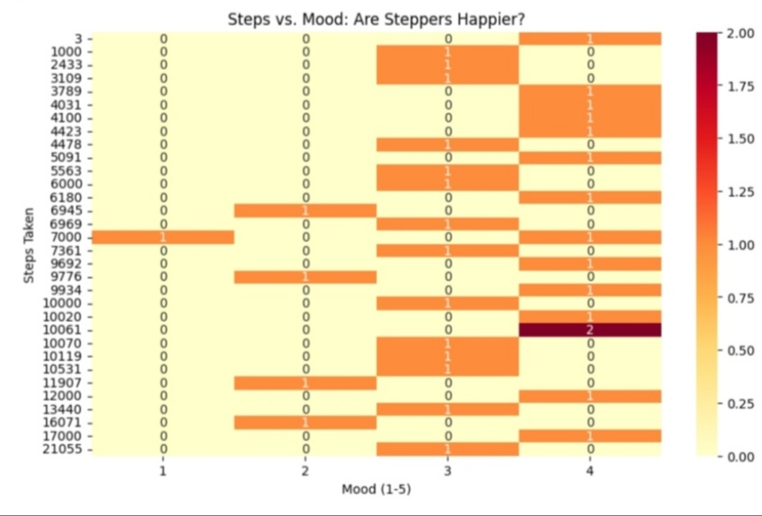
Mood & Activity: The Steps-Mood Heatmap
Our heatmap reveals a compelling link between daily steps and reported mood. Corps members logging between 6,000 and 10,000 steps consistently reported moderate moods.
Notably, the highest mood score of 4 was associated with precisely 10,061 steps, suggesting an optimal activity level for well-being.

Slide 4
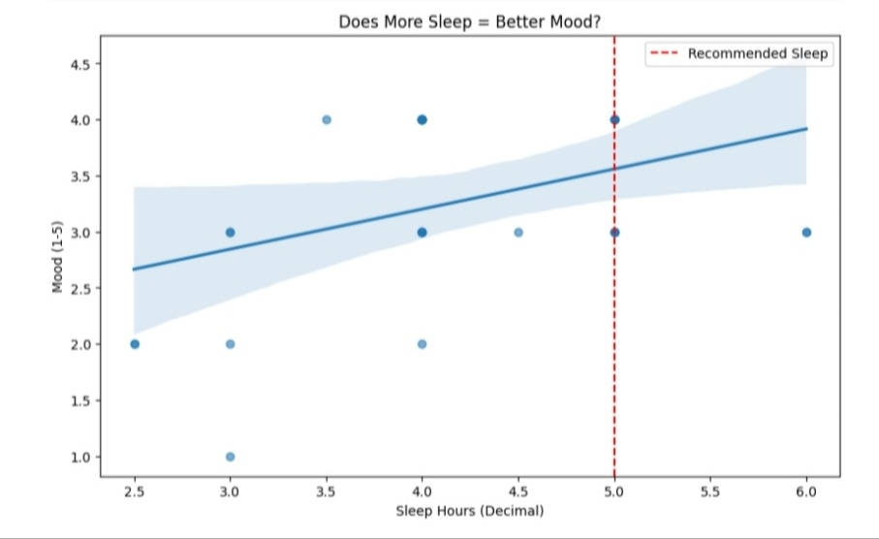
Sleep Quality and Mood Connection
Conversely, mood levels noticeably dip when sleep duration falls below 4 hours. This highlights the critical role of adequate rest in maintaining overall well-being and emotional balance.
Prioritizing sleep within the optimal range could be a key factor in boosting daily mood for the corps members.
The scatter plot illustrates a clear trend: mood scores improve significantly when corps members achieve 4.5 to 6 hours of sleep. This range appears to be crucial for positive mental states.

Slide 5
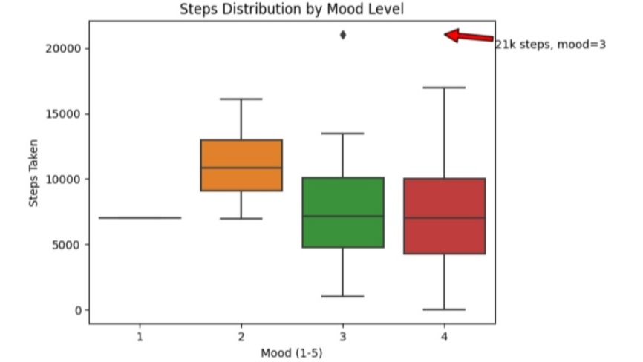
Optimal Activity for Higher Moods: Box Plot Insights
The box plot distinctly shows that higher mood levels (3-4) are strongly correlated with daily step counts ranging from 10,000 to 21,000 steps.
In contrast, mood scores below 3 are typically associated with step counts less than 5,000. This reinforces the idea that consistent physical activity is a significant contributor to better emotional well-being among corps members.

Slide 6
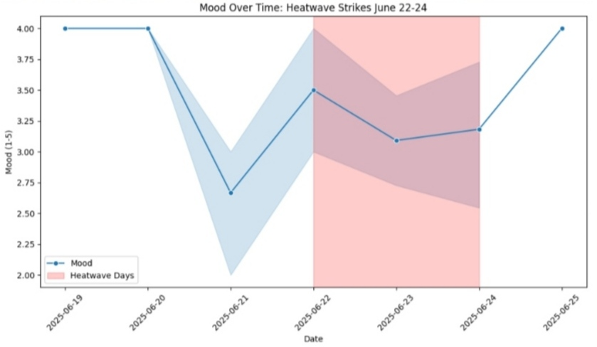
Heatwave Impact on Mood: A Timely Decline
The line plot vividly illustrates a significant drop in reported mood levels among corps members during the intense heatwave experienced from June 22nd to 24th.
Following this period, a clear recovery trend is observed, with mood levels gradually returning to their previous averages. This highlights the direct influence of environmental factors, such as extreme weather, on the psychological well-being of the youth.

Slide 7
Key Takeaways: Promoting Well-being in Sokoto
Optimal Activity Levels
Prioritizing Sleep
Environmental Resilience
Targeting 6,000-10,000 steps, with an emphasis on the 10,061 mark, can significantly boost mood.
Ensuring 4.5-6 hours of sleep is crucial for improved mood, with less than 4 hours negatively impacting well-being.
Awareness and support mechanisms are needed to mitigate the impact of environmental stressors like heatwaves on mental health.

Slide 8

Next Steps: Advancing Research & Intervention
Conduct longitudinal studies to observe long-term trends and validate correlations.
Implement pilot programs based on these findings, such as targeted activity challenges or sleep hygiene workshops, to assess their impact on mood.
Explore additional data points, like diet and social interaction, for a more holistic understanding of youth well-being.
Collaborate with local health organizations to integrate insights into existing support systems for corps members.

Slide 9


